Slide 1


Mobile Platform Basics Using an Arduino Motor Shield and C Programming
ELECTRICAL ENGINEERING AND COMPUTER SCIENCE, COLLEGE OF ENGINEERING AND PHYSICAL SCIENCES
Notes:
Updated 18 Jun 2024 by Noah Mulvaney

Slide 2
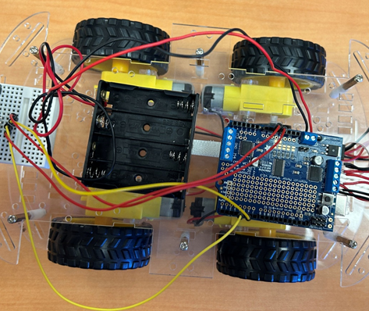
Goals
To understand how to use the Adafruit Motor Shield to control four DC motors.
To understand how to combine the movement of the four motors to control the mobile platform.

Slide 3
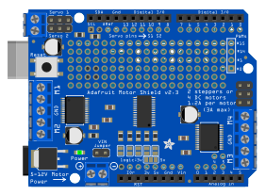
Adafruit Motor Shield v2.3
⑧
① DC power supply (AA battery pack)
② Power indicator LED
③ M1 motor connection ports
④ M2 motor connection ports
⑤ M3 motor connection ports
⑥ M4 motor connection ports
⑦ GND
⑧ Reset button
③
⑥
⑦
⑦
④
⑤
②
①

Slide 4
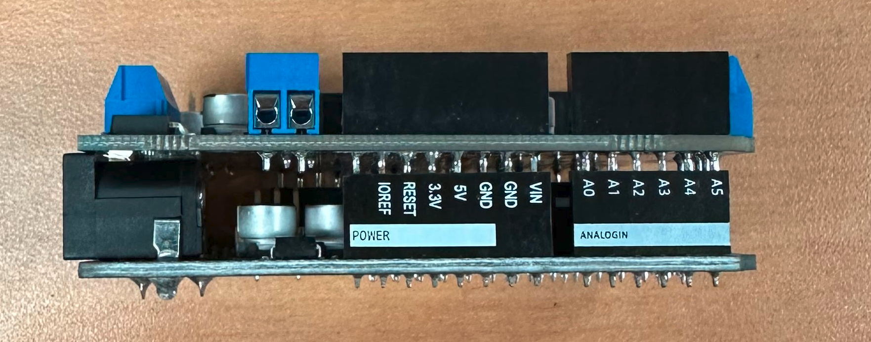
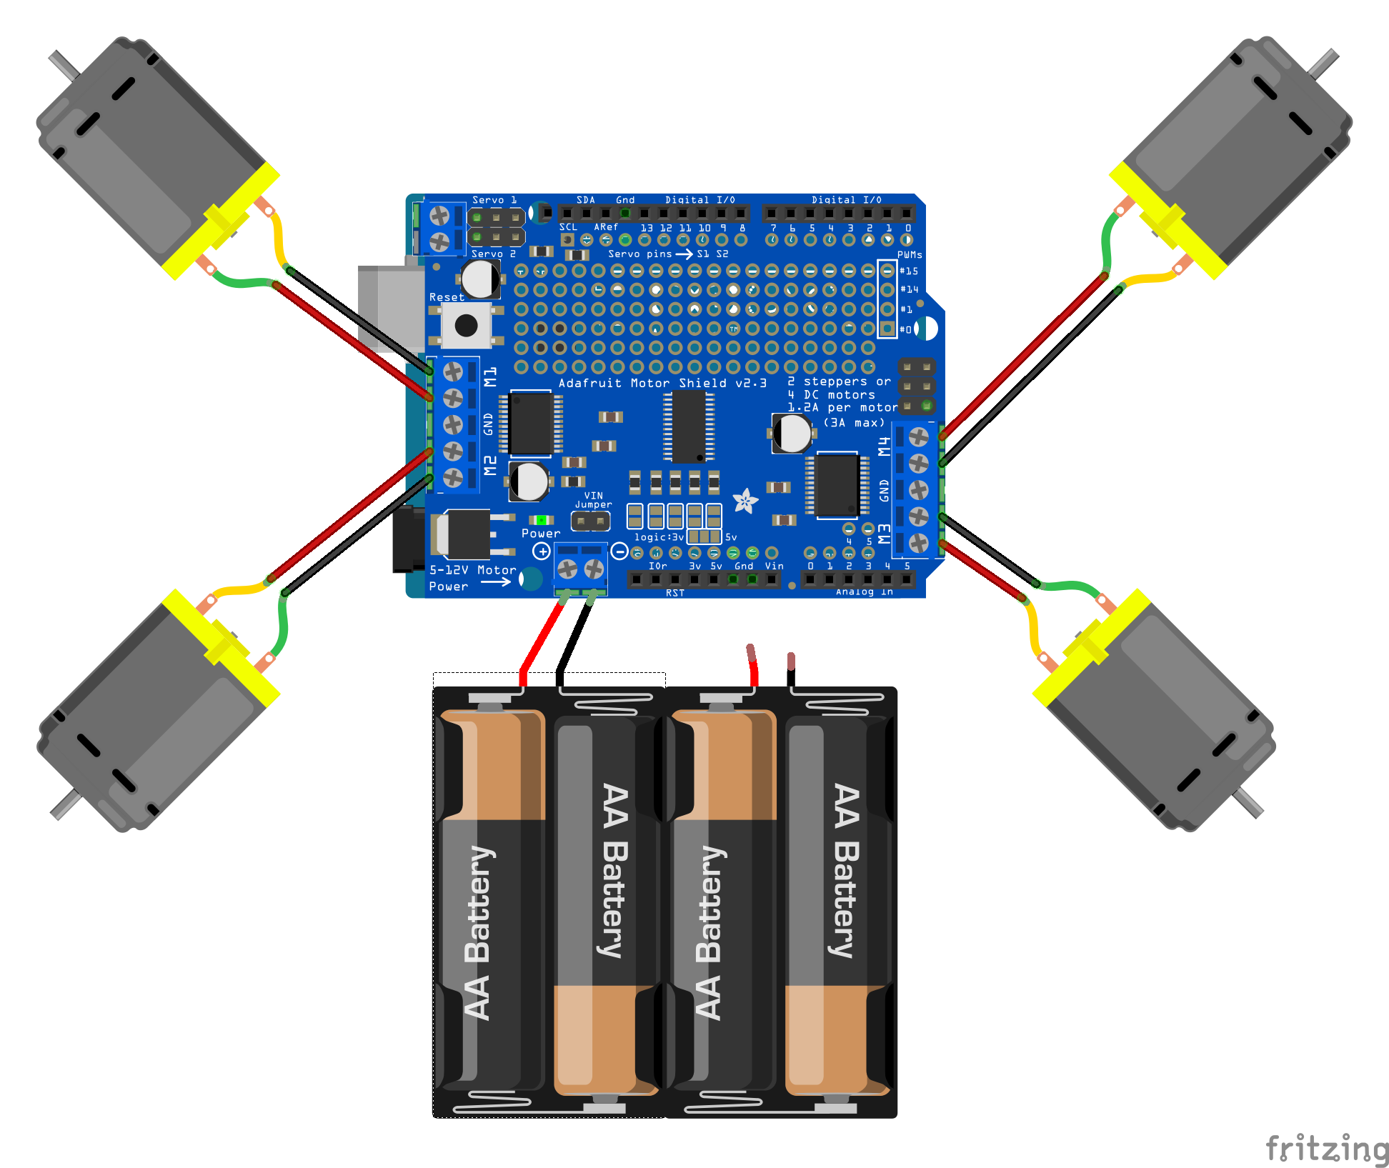
Installing the Motor Shield
Attach the motor shield to the Arduino board.
Try to avoid bending the pins.
You can now connect the motors and the battery to the shield.
The direction (plus vs. minus) of the DC motors does not matter at this point. If they spin the wrong direction, we will just swap the polarity
Be sure the battery pack is connected in the correct directions. Red to positive; black to negative.
Do not put all four batteries in the battery pack until you have double checked your circuit.
M4 Rear Right Motor
M1 = Front Left Motor
M2 = Front Right Motor
M3 Rear Left Motor

Slide 5
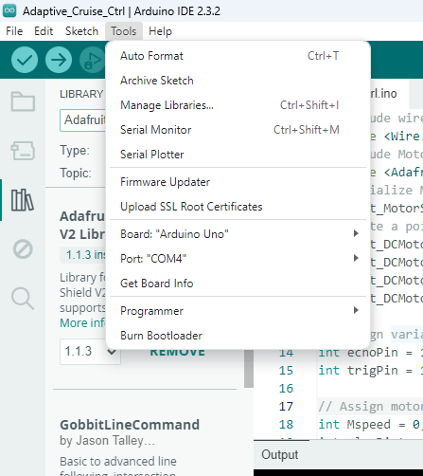
Installing Libraries
We need to install a library to use the motor shield
Click on ‘Tools’ at the top left
Locate ‘Manage Libraries’ and click on it
Search for ‘Adafruit Motor Shield V2 Library’ and install this library

Slide 6
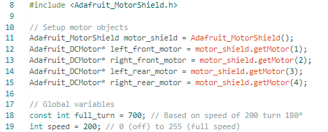
Code

Slide 7
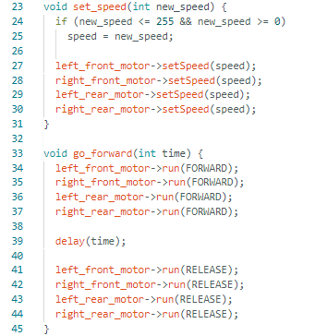
Code

Slide 8
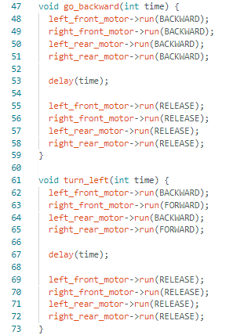
Code

Slide 9
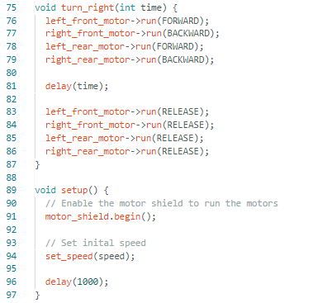
Code

Slide 10
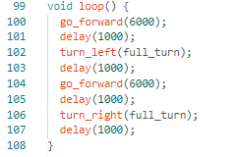
Code
Write your own route for the platform.

Slide 11
Experiment
If needed, you can switch the connection of a motor with the shield to reverse the motor.
Change the route planned by altering the code in the loop function.
We will build on this module to design an adaptive cruise control system.

